Slide 1
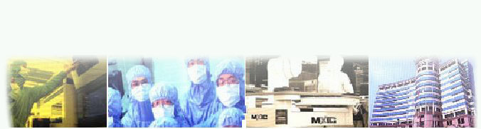
MACRONIX INTERNATIONAL CO., LTD.
Consumer Application Dept./Technical Service Div.
MIDI Introduction
(Musical Instrument Digital Interface)
By : Peter Chang
May, 2002

Slide 2
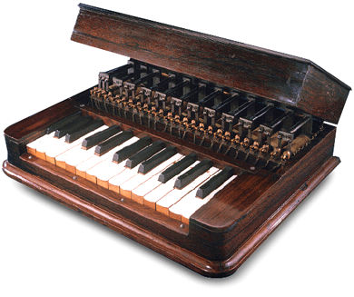
Agenda
History
System
Specific
Synthesis Technology
Overview
MX92L832
Elisha Gray's Musical Telegraph of 1876.

Slide 3
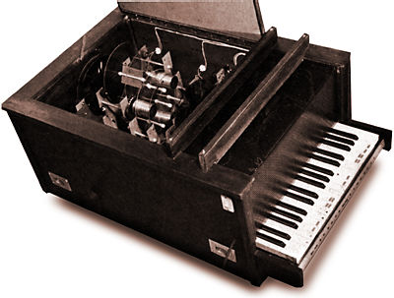
History - 1
1870 ~ 1960, Electronic musical
instrument was build by
single-tone oscillators.
1960 decade,
* Dr. Robert Moog at New York
use MCU invent Analog Synthesizer.
* Dr. Max Mathew at Bell Lab. Use
MCU invent Digtal/Analog
Converter Synthesizer.
1970 decade, Oberhim announce 4 tone electronic instrument.
1980 decade, VLSI technology course component price decrease; New generation electronic instrument is more easy to use, reliable and popular.
The Optophonic Piano of Vladimir Baranoff Rossine (1916)

Slide 4
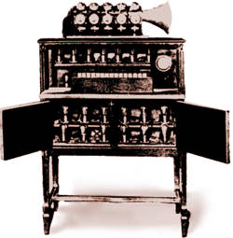
History - 2
1978, Roland invite YAMAHA、
KORG and some Europe electronic
instrument maker to study the
standard communication method.
1981, Sequential Circuits, Roland and
Oberheim Electronics meeting at
NAMM(National Association of Music Merchants) June show and then USI (Universal Synthesizer Interface) be announced in Audio Engineers Society at November, 1981.
January, 1982; More electronic instrument maker join USI specific discussion.
June, 1982; USI rename to MIDI (Musical Instrument Digital Interface)
The Pianorad, showing oscillators and speaker horn. (1926)

Slide 5

History - 3
End of 1982, MIDI standard released.
January, 1983, Sequential Circuits Prophet 600 was succeeded communicate with Roland JP-6 in NAMM show.
29 June, 1983, JMSC(Japanese MIDI Standard Committee) established.
1983, IMUG (International MIDI Users' Group) established in U.S.A.
1984, Yamaha and other MIDI maker establish MMA (MIDI Manufacturers Association) for maintain MIDI specific.
Hammond L133 (1935)

Slide 6
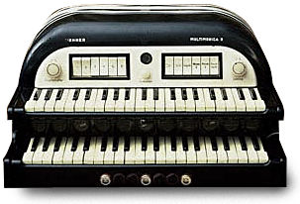
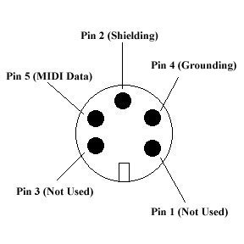
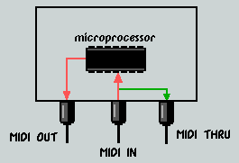


System-MIDI Port
MIDI Port - IN, OUT, THRU
MIDI Cable & Connection
The Hohner Multimonica (1940)
Pin 1, 3 unused

Slide 7
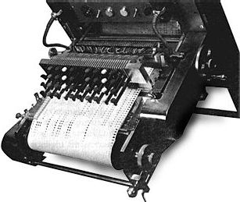

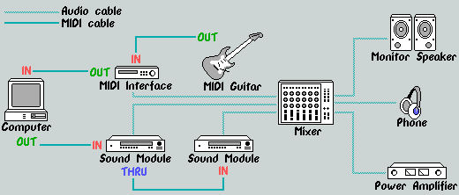
System- MIDI Connection
OUT to IN or THRU to IN
An Expended MIDI System
The punch-paper keyboard input of the RCA MKII (1956)

Slide 8
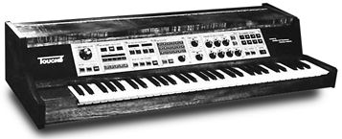
Specific-Transmission Speed
MIDI is an asynchronous serial
interface.
The baud rate is 31.25 K baud.
There is 1 start bit, 8 data bits, and 1 stop bit (ie, 10 bits total), for a period of 320 microseconds per serial byte.
The Buchla Touche Synthesiser (1963)

Slide 9
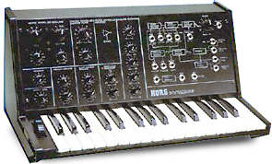
Specific-MIDI Channel.1
Total 16 MIDI channel supported
in MIDI data stream.
Every MIDI channel support 4
kind reception modes.
Mode 1 - Omni-On Poly
Mode 2 - Omni-On Mono
Mode 3 - Omni-Off Poly
Mode 4 - Omni-Off Mono
The Korg MS10 Analogue synthesiser (1975)

Slide 10
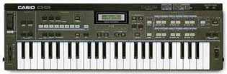
Specific-MIDI Channel.2
Omni-On : The receiving device
listens and responds to all incoming
MIDI channel data.
Omni- Off : The MIDI device will listen to all incoming channel data but only responds to information set to one particular channel.
Poly : Dependents on the number of voices that a MIDI device can play at any given moment in time.
Mono : Though the instrument will only play one note at a time.
The Casio CZ101 Digital Synthesiser (1981)

Slide 11
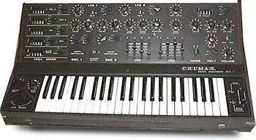
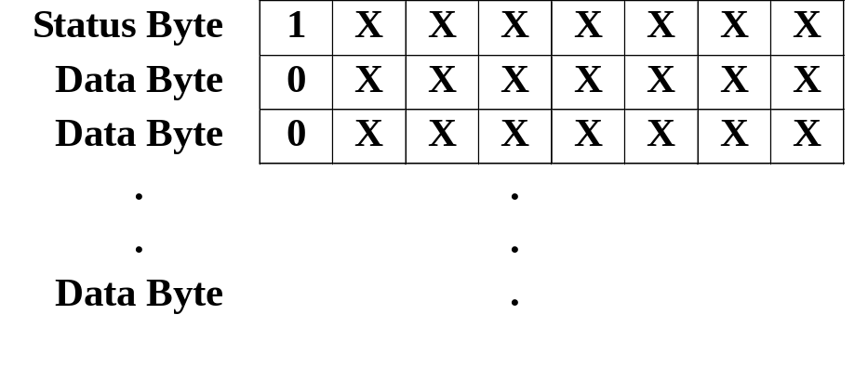
Specific-MIDI Message.1
MIDI data stream
Crumar DS2 Synthesiser (1985)

Slide 12
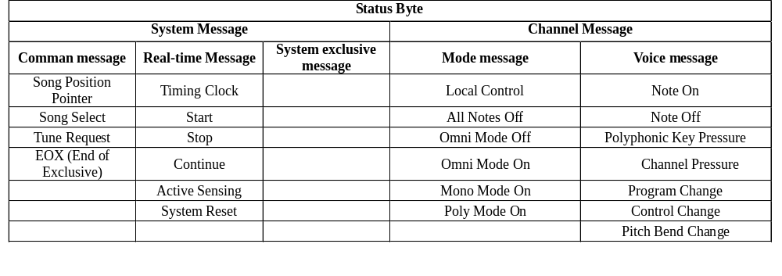
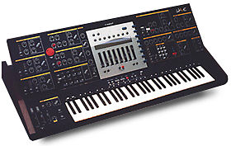
Specific-MIDI Message.2
The Waldorf Wave wavetable synthesiser (1992)

Slide 13
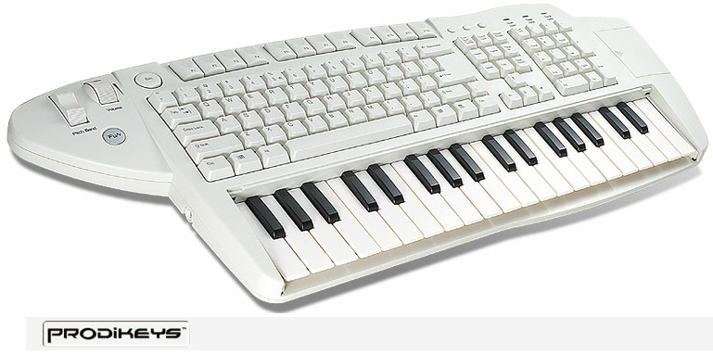

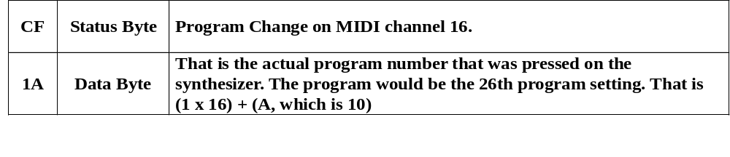
Specific-MIDI Message.3
Creating a Program Change
Creative Computer MIDI Keyboard (2002)

Slide 14
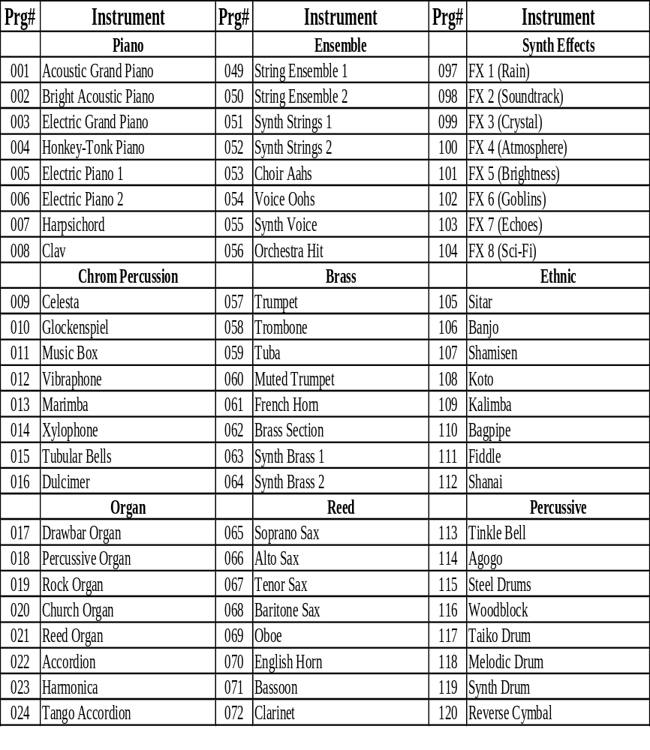
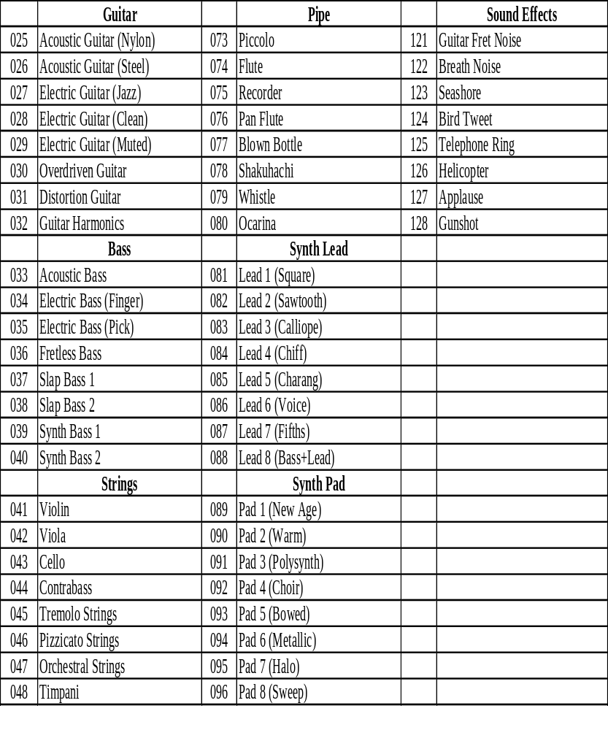
Specific-GM 1.0 Instrument
GENERAL MIDI INSTRUMENT MAP

Slide 15
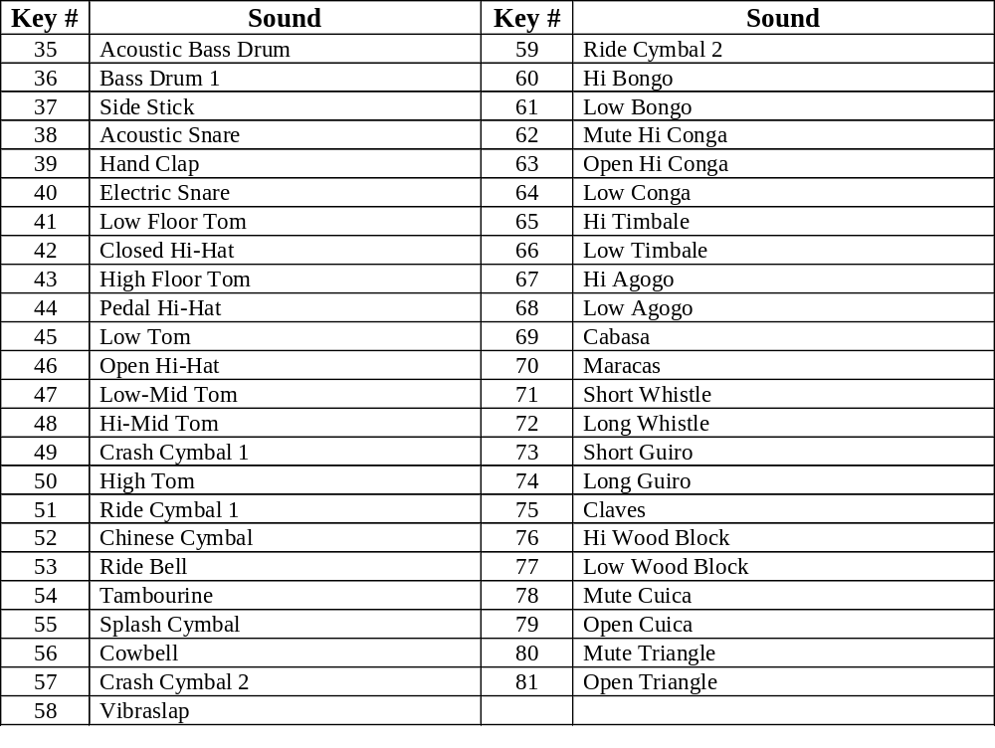
Specific-GM 1.0 Drum Sounds
GENERAL MIDI INSTRUMENT MAP

Slide 16
Audio Synthesis Technologies
Audio synthesis technology is actually an method of producing sounds where no acoustic sound is used
Among audio synthesis technologies, FM (Frequency Modulation) and Wavetable Synthesis are now mainstream Audio technologies
Audio synthesis technologies are now wildly applied to many applications like
  Music Keyboard
  Cell phone sound generator
  Toys
  Melody accessories

Slide 17
Wavetable Synthesis Technology
u-Law Compression
Sound Model
Loop
Envelope Control
Pitch shift
Interpolation

Slide 18
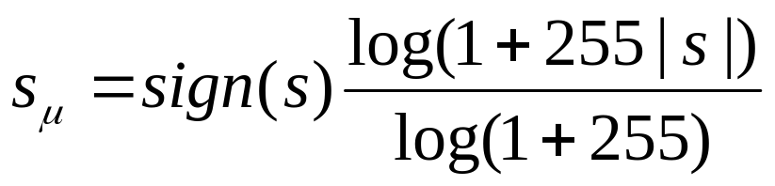
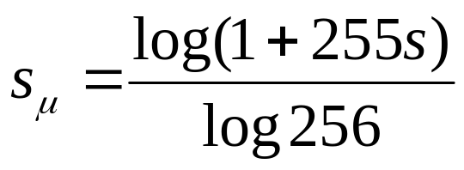
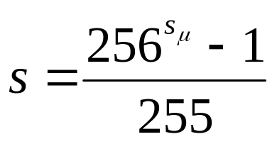
u-Law Compression
Converts linear 16-bit samples into 8-bit codes
Assume all samples are fractional values between -1 and 1
8-bit u-Law codes
16-bit linear samples

Slide 19
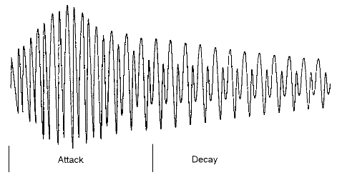
A Typical Waveform of Sound

Slide 20
Sound Model
ADSR Model
  A (Attack), D (Decay), S (Sustain), R (Release)
  For non-percussive instruments (e.g. violin)
0 dB
D
amplitude
attenuation
A
S
R
note on
note off
time

Slide 21
Sound Model
ADSR Model
  For percussive instruments (e.g. piano, drum)
0 dB
D
amplitude
attenuation
A
S
R
note on
note off
time

Slide 22
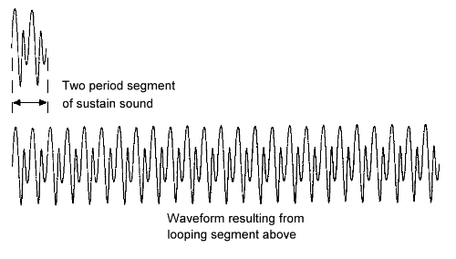
Loop

Slide 23
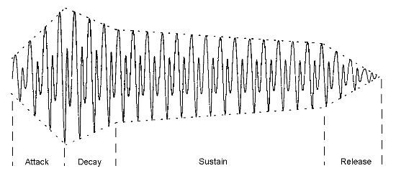
Envelope Control

Slide 24
Pitch shift
Use one or limited sound samples of notes to generate all notes you want to perform
Access the stored sample memory at different rates during playback
Memory
Memory
Pointer
Pointer
Some particular pitch
Pitch shifted up by one octave
fs
2fs

Slide 25
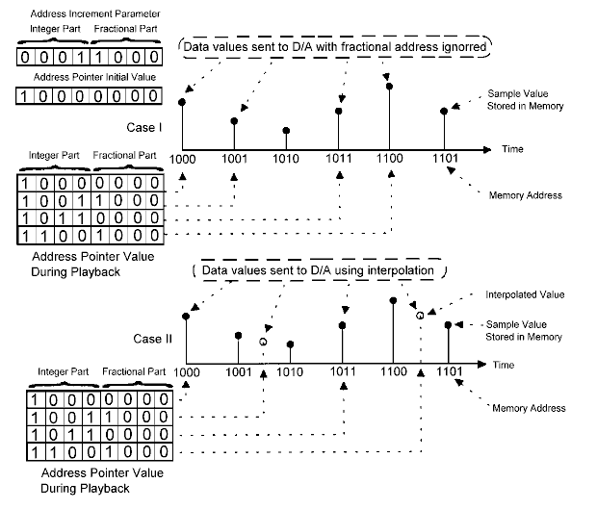
Interpolation

Slide 26
Wavetable System Implementation
Audio Out (L)
RAM
DAC
Audio Out (R)
MIDI IN
Micro
Processor
Wavetable
Synthesizer
Program
ROM
Wavetable
ROM

Slide 27
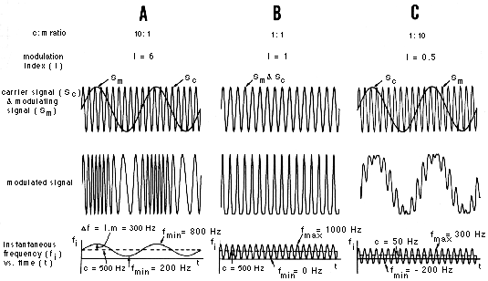
FM (Frequency modulation)
FM is actually a process of varying the frequency of a signal, often periodically;

Slide 28
FM (Frequency Modulation)
Fundamental principle of FM sound generator is to synthesizing tones by combining “modulation signal” and “carrier” signal.
Modulator
FM
Modulation
Output Sound
Carrier
(Sine wave)
Pyramidal Wave
Created
Saw toothed Wave
Created
Oblong Wave
Created
Carrier
Created
Parameter
Parameter
Parameter

Slide 29
FM (Frequency Modulation)
A device producing “carrier” or “modulator” is called an “operator”
At least two operators are required to generate sound of a musical instrument.
For percussion instruments, at least 4 operators are required if expecting decent instrumental sound quality

Slide 30
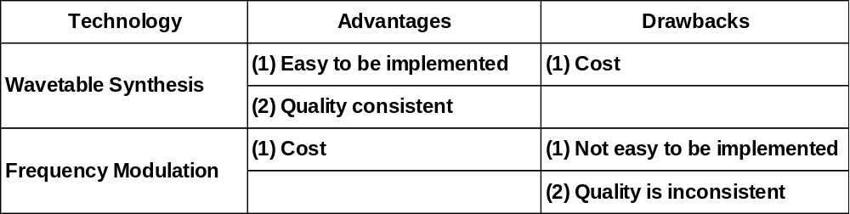
Audio Synthesis Comparison
Theoretically, FM and Wavetable synthesis can achieve the same audio quality.

